Slide 1
Lecture 4: Asymptotic Analysis
Keren Zhu
kerenzhu@cse.cuhk.edu.hk

Slide 2
Topics for this lecture
Asymptotic Analysis
A mathematical tool helps us describe the growth of functions

Slide 3
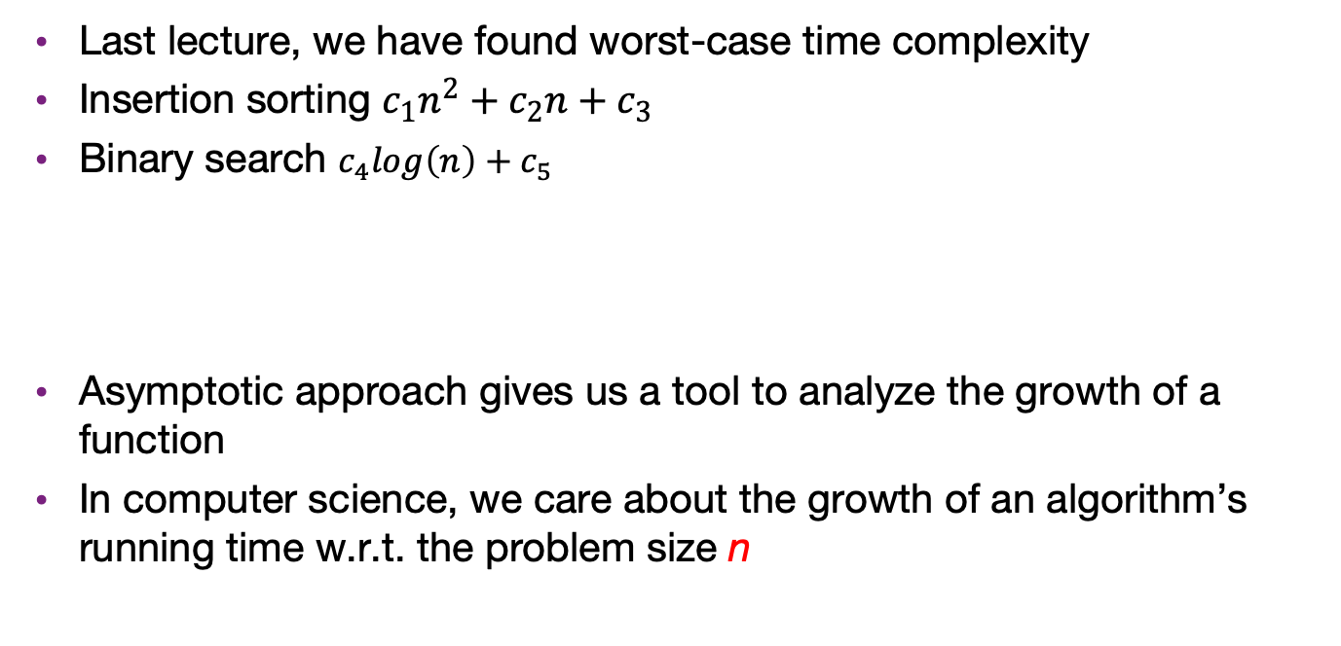

What is asymptotic analysis
Last lecture, we have found worst-case time complexity
Insertion sorting $c_{1}n^{2}+c_{2}n+c_{3}$
Binary search $c_{4}log\left(n\right)+c_{5}$
Asymptotic approach gives us a tool to analyze the growth of a function
In computer science, we care about the growth of an algorithm’s running time w.r.t. the problem size n
$$O\left(n^{2}\right)$$
$$O\left(\log\left(n\right)\right)$$

Slide 4
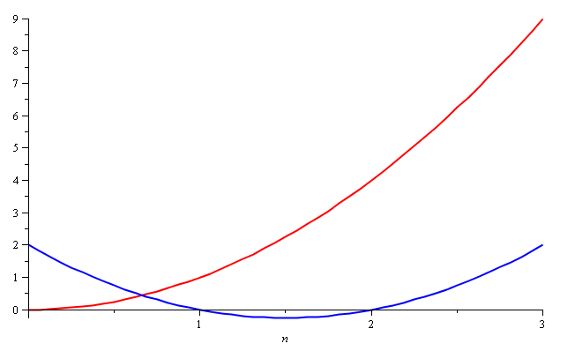
Why is growth important?
Consider the two functions
f(n) = n² and g(n) = n² – 3n + 2
Around n = 0, they look very different

Slide 5
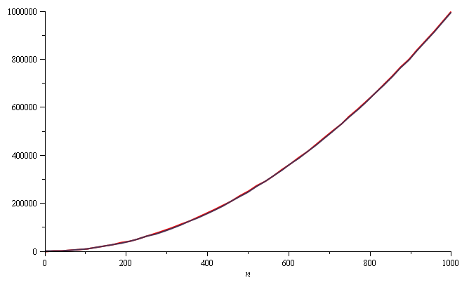
Why is growth important?
Yet on the range n = [0, 1000], they are (relatively) indistinguishable:

Slide 6
Why is growth important?
The absolute difference is large, for example,
f(1000) = 1 000 000
g(1000) = 997 002
but the relative difference is very small
and this difference goes to zero as n → ∞

Slide 7
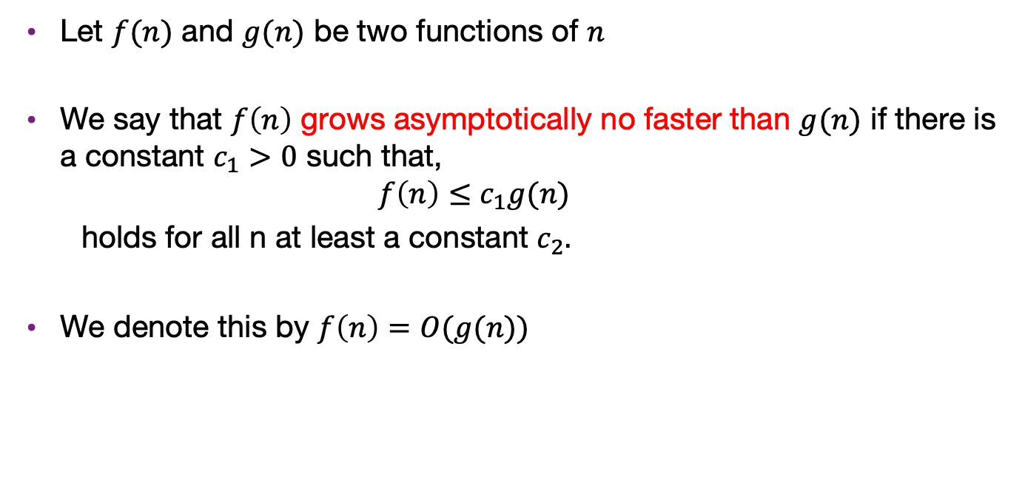
The big-O notation
Let $f(n)$ and $g(n)$ be two functions of $n$
We say that $f\left(n\right)$ grows asymptotically no faster than $g(n)$ if there is a constant $c_{1}>0$ such that,
$$f\left(n\right)≤c_{1}g(n)$$
holds for all n at least a constant $c_{2}.$
We denote this by $f\left(n\right)=O(g(n))$

Slide 8

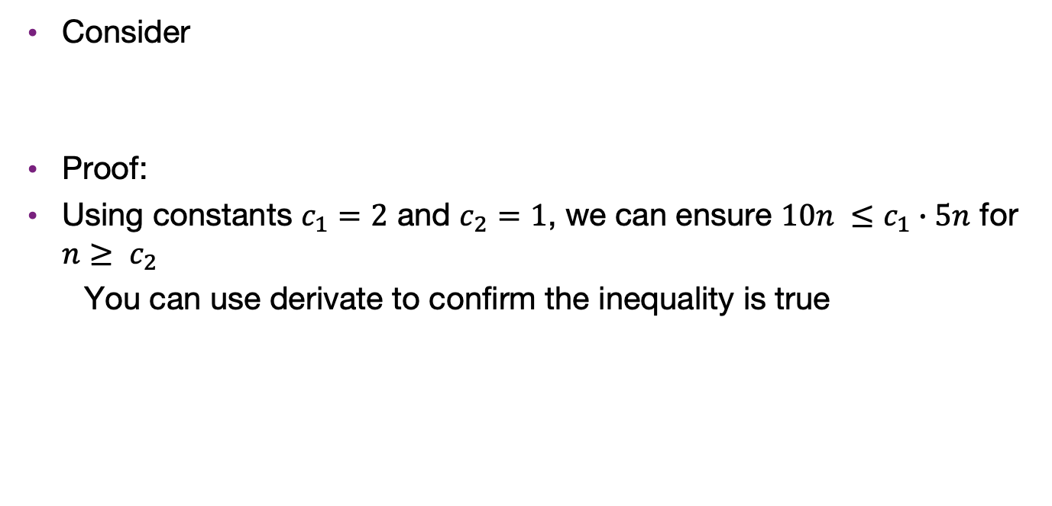
Example 1
Consider
Proof:
Using constants $c_{1}=2$ and $c_{2}=1$, we can ensure $10n ≤c_{1}∙5n$ for $n≥ c_{2}$
You can use derivate to confirm the inequality is true
$$f\left(n\right) = 10n = O\left(5n\right)$$

Slide 9


Example 2
Consider
Proof:
Using constants $c_{1}=1$ and $c_{2}=2^{20}$, we can ensure$10000⋅log⁡(n)≤c_{1}∙n$ for $n≥ c_{2}$
Note: This is not a tight bound
$$f\left(n\right) =10000⋅log⁡(n) = O\left(n\right)$$

Slide 10

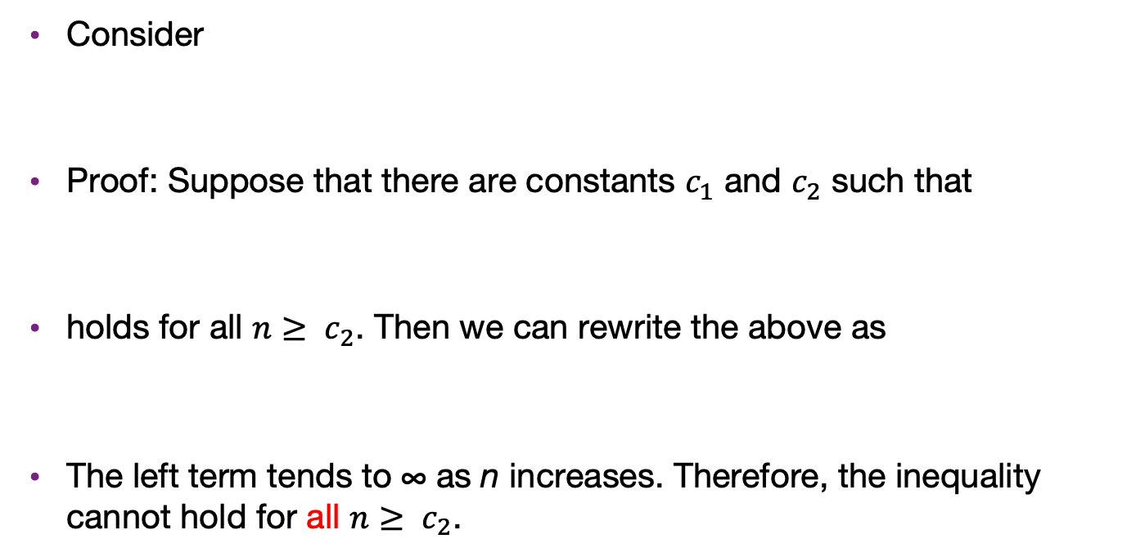


Example 3
Consider
Proof: Suppose that there are constants $c_{1}$ and $c_{2}$ such that
holds for all $n≥ c_{2}$. Then we can rewrite the above as
The left term tends to ∞ as n increases. Therefore, the inequality cannot hold for all $n≥ c_{2}$.
$$f\left(n\right)=n≠O\left(10000log\left(n\right)\right)$$
$$n≤c_{1}⋅10000log\left(n\right)$$
$$\frac{n}{log\left(n\right)}≤c_{1}⋅10000$$

Slide 11
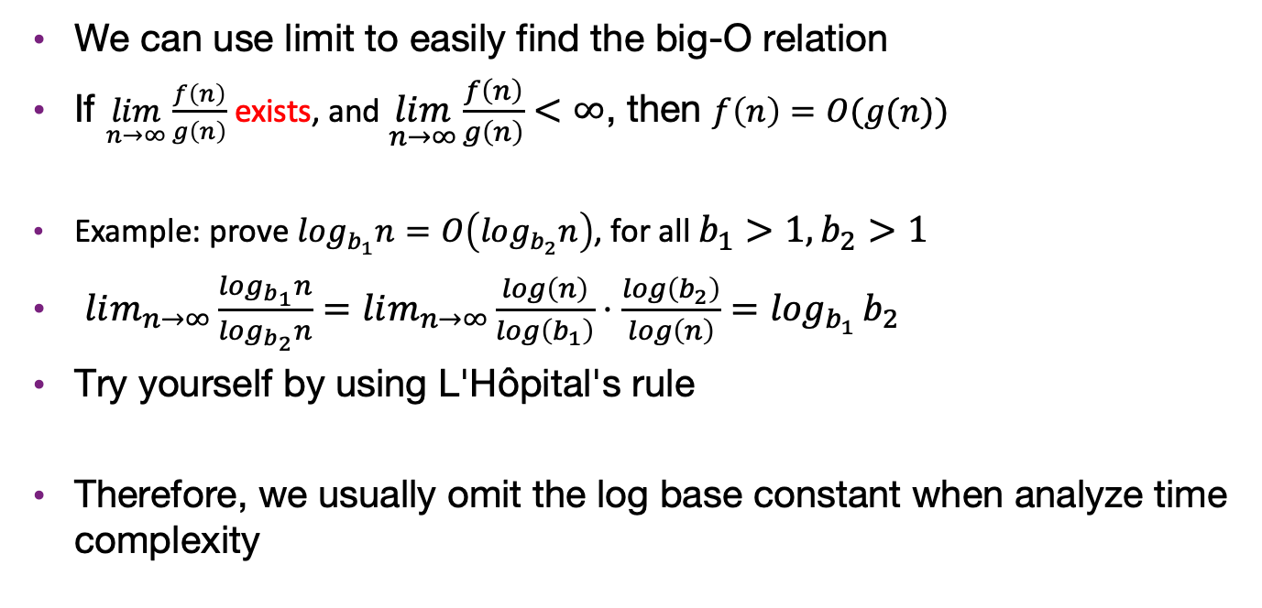
Relation with limits
We can use limit to easily find the big-O relation
If $\lim_{n→∞}{\frac{f\left(n\right)}{g\left(n\right)}}$ exists, and $\lim_{n→∞}{\frac{f\left(n\right)}{g\left(n\right)}}<∞$, then $f\left(n\right)=O(g(n))$
Example: prove $log_{b_{1}}n=O\left(log_{b_{2}}n\right)$, for all $b_{1}>1,b_{2}>1$
$lim_{n→∞}\frac{log_{b_{1}}n}{log_{b_{2}}n}=lim_{n→∞}\frac{log\left(n\right)}{log\left(b_{1}\right)}⋅\frac{log\left(b_{2}\right)}{log\left(n\right)}=\log_{b_{1}}{b_{2}}$
Try yourself by using L'Hôpital's rule
Therefore, we usually omit the log base constant when analyze time complexity

Slide 12
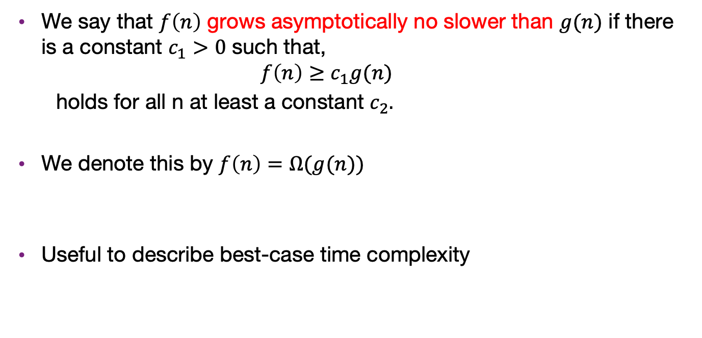
The big-$Ω$ notation
We say that $f\left(n\right)$ grows asymptotically no slower than $g(n)$ if there is a constant $c_{1}>0$ such that,
$$f\left(n\right)≥c_{1}g(n)$$
holds for all n at least a constant $c_{2}.$
We denote this by $f\left(n\right)=Ω(g(n))$
Useful to describe best-case time complexity

Slide 13
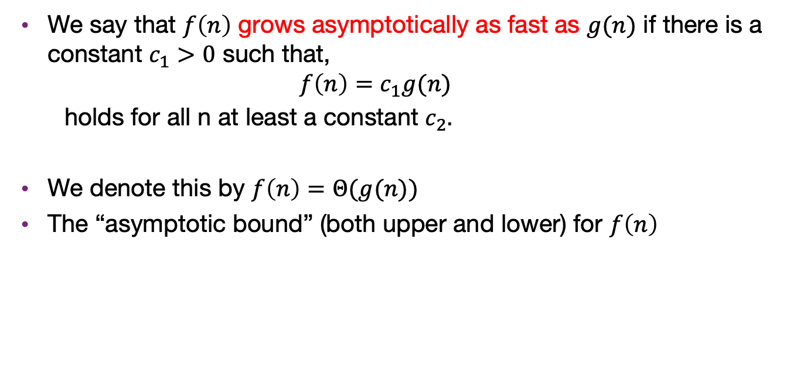
The big-$Θ$ notation
We say that $f\left(n\right)$ grows asymptotically as fast as $g(n)$ if there is a constant $c_{1}>0$ such that,
$$f\left(n\right)=c_{1}g(n)$$
holds for all n at least a constant $c_{2}.$
We denote this by $f\left(n\right)=Θ(g(n))$
The “asymptotic bound” (both upper and lower) for $f\left(n\right)$

Slide 14
Limit definition of Landau symbols

